Slide 1



Digital Health Innovation:
Interpreting County-Level COVID-19 Infections using Transformer and Deep Learning Time Series Models
IEEE International Conference on Digital Health, 2023
Md. Khairul Islam, Yingzheng Liu, Andrej Erkelens, Nicholas Daniello, Aparna Marathe and Judy Fox

Slide 2


Moving From “Intervention” to “Prevention”
Infectious diseases: a global societal problem
By 2050, projected deaths/year due to antimicrobial resistance > 10 million; economic impact > $100 trillion
100 million cases, 1.1 million deaths in the US alone
COVID-19 is a complex data problem
Non-stationary nature, new variants, and noisy data make it quite difficult to learn and predict disease trends
Making infection forecasting interpretable can help deciding policy
Interpretable features can help identify important spatial and temporal “focus areas,” signalling governments to more efficiently allocate resources to prevent disease spread
Notes:
https://www.cdc.gov/nchs/nvss/vsrr/covid_weekly/index.htm
Infectious disease has been a global problem impacting public health and economics on a large scale.
The COVID-19 pandemic is one such example, which in the recent years has caused a huge number of deaths and millions of cases all over the globe. However predicting the spread of such disease is difficult due to its dynamic nature and noise in the reporting process.

Slide 3
Problem Statement
Examination of the current role of Interpretable AI for COVID-19 pandemic
General issues (accuracy, interpretability)
County-level characteristics
Real-time decision making
Health disparities
Noisy Data
Population Level Policy
Missing Data
Interpretable and Real-Time Digital Health System
Vaccine
Unknown Data
Hospital Resources
Workplace Policy
School open/close

Slide 4
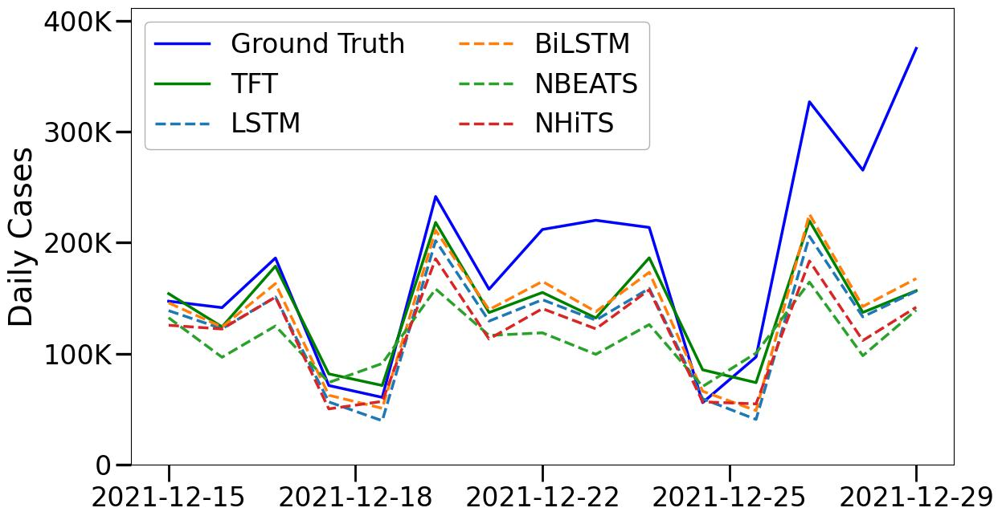
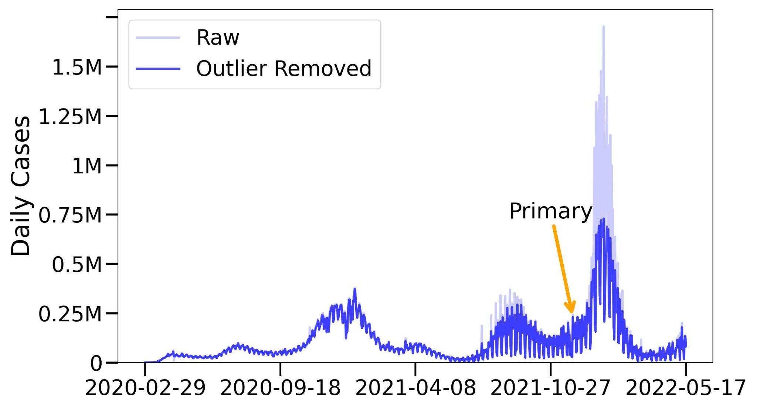
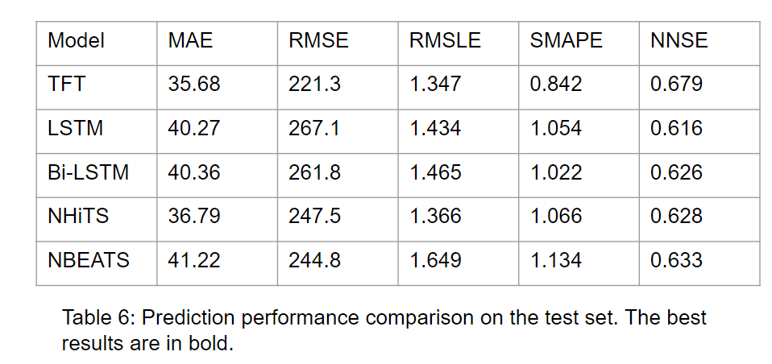
Methodology & Benchmarking
Test results comparison
We collected 2.5+ years of socioeconomic and observed features for 3142 US counties at the daily level. Our project site: https://github.com/Data-ScienceHub/gpce-covid

Slide 5
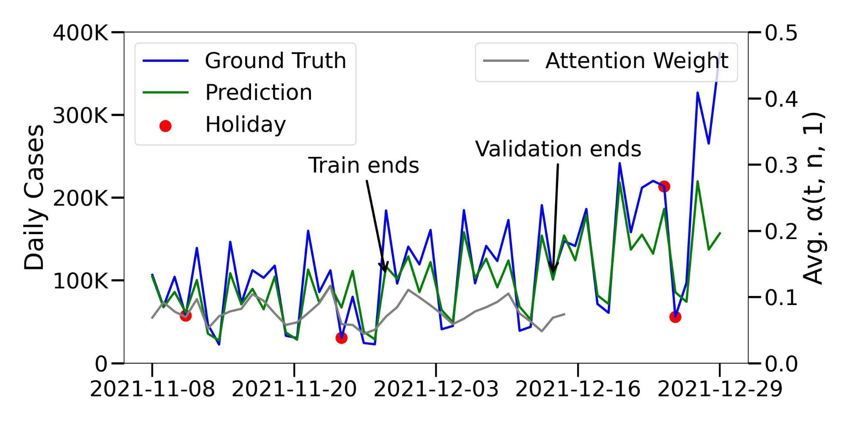
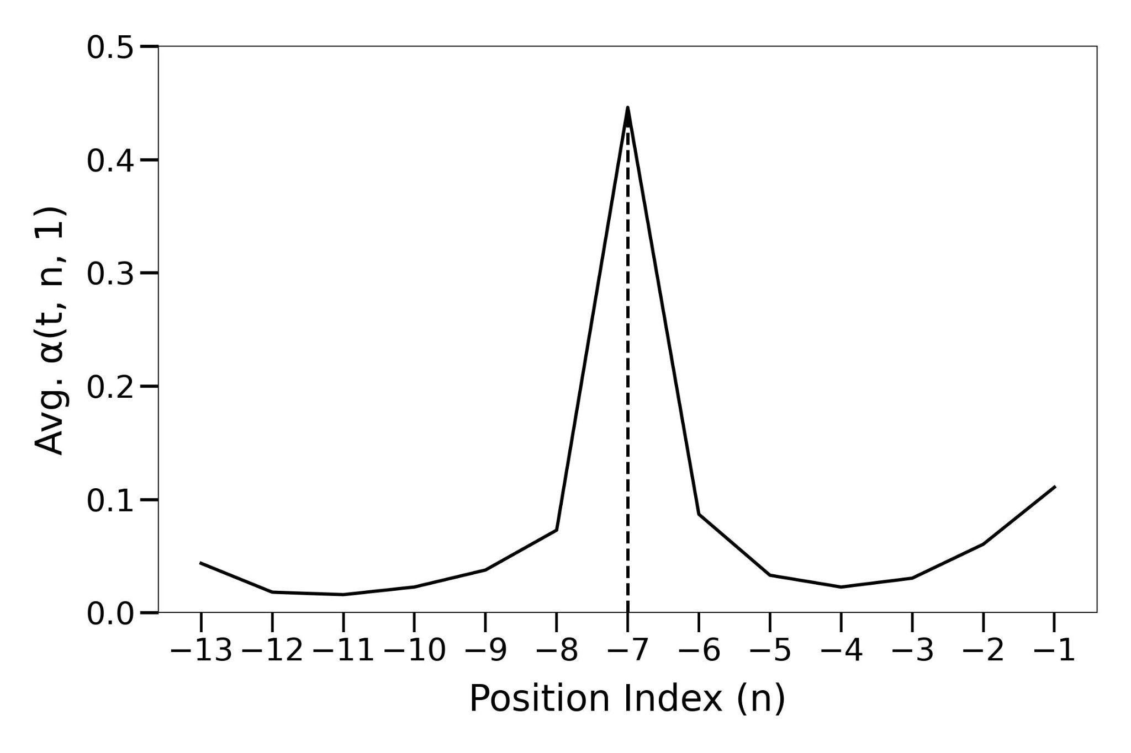
Interpreting Temporal Patterns
Cyclic patterns show less the TFT model gives less attention weights to holidays (Thanksgiving, Christmas).
Attention weights aggregated by past time index showing high importance in the same day the previous week.

Slide 6
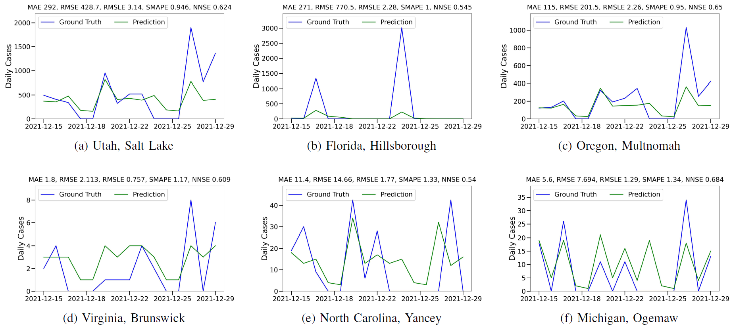
Spatial Trends at County Level
Prediction performance of TFT for six randomly selected US counties. The top row contains counties selected from the top 100 US counties by population. The bottom row of counties is selected from the rest.

Slide 7
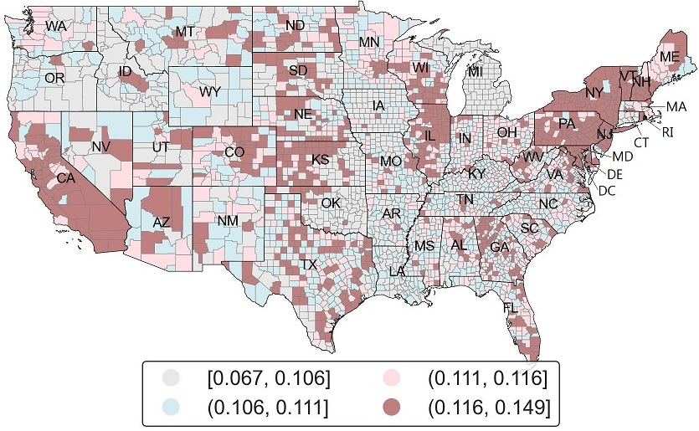
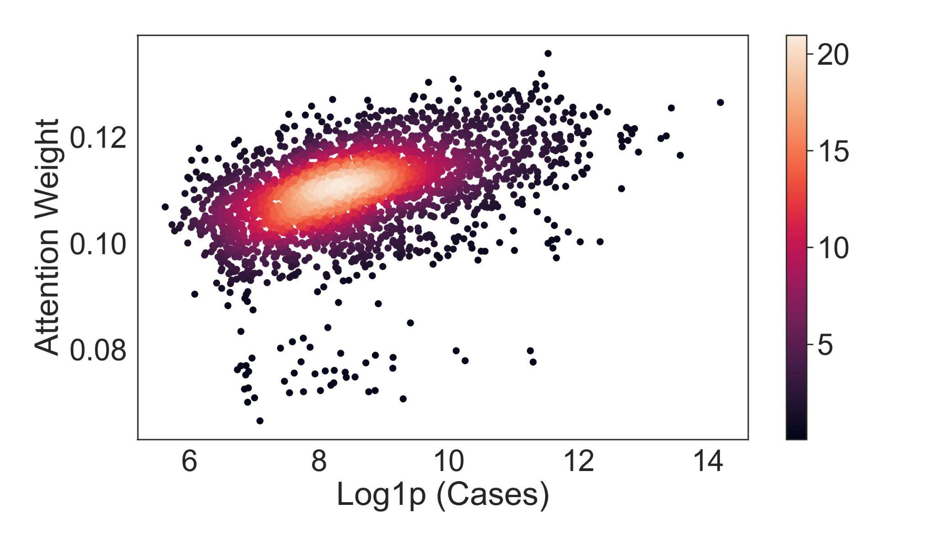
Interpreting Spatial Patterns with Attention
Correlation density between aggregated COVID-19 cases and TFT model’s attention weights per county.
Avg. self-attention weights across US counties from TFT. Highlighting regions of interest that gets more attention in COVID-19 infection forecasting.

Slide 8

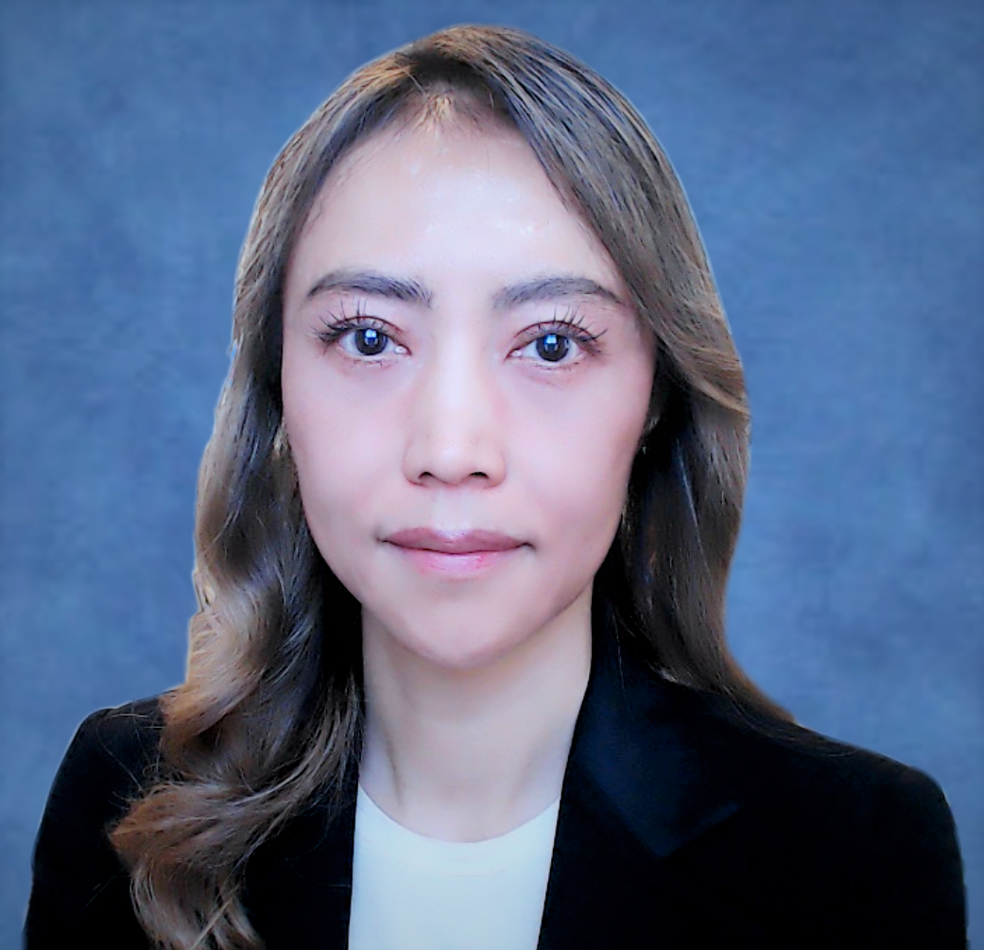

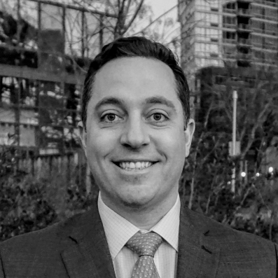

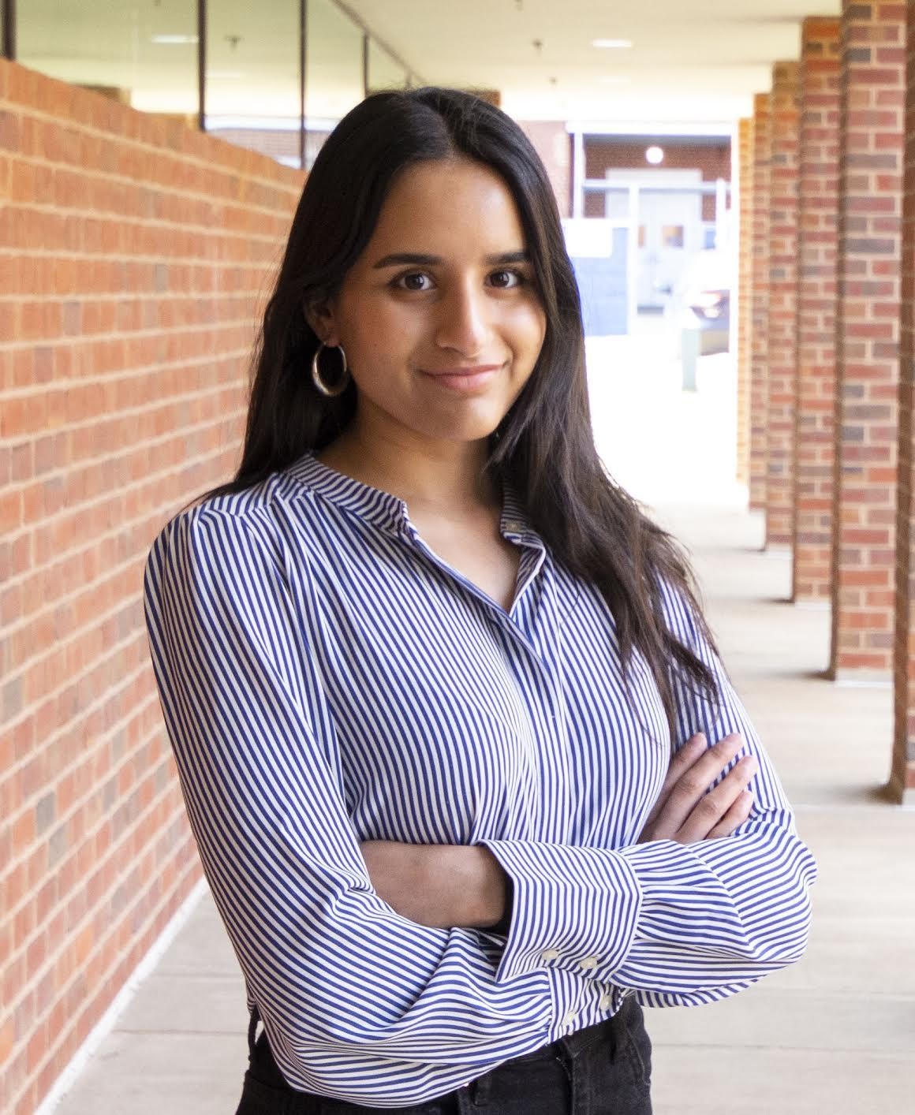

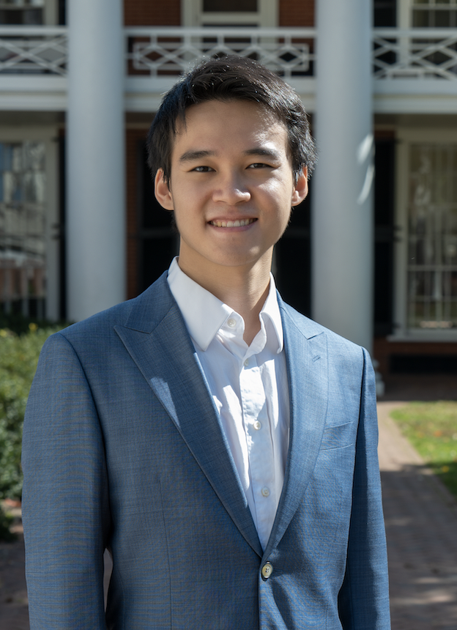

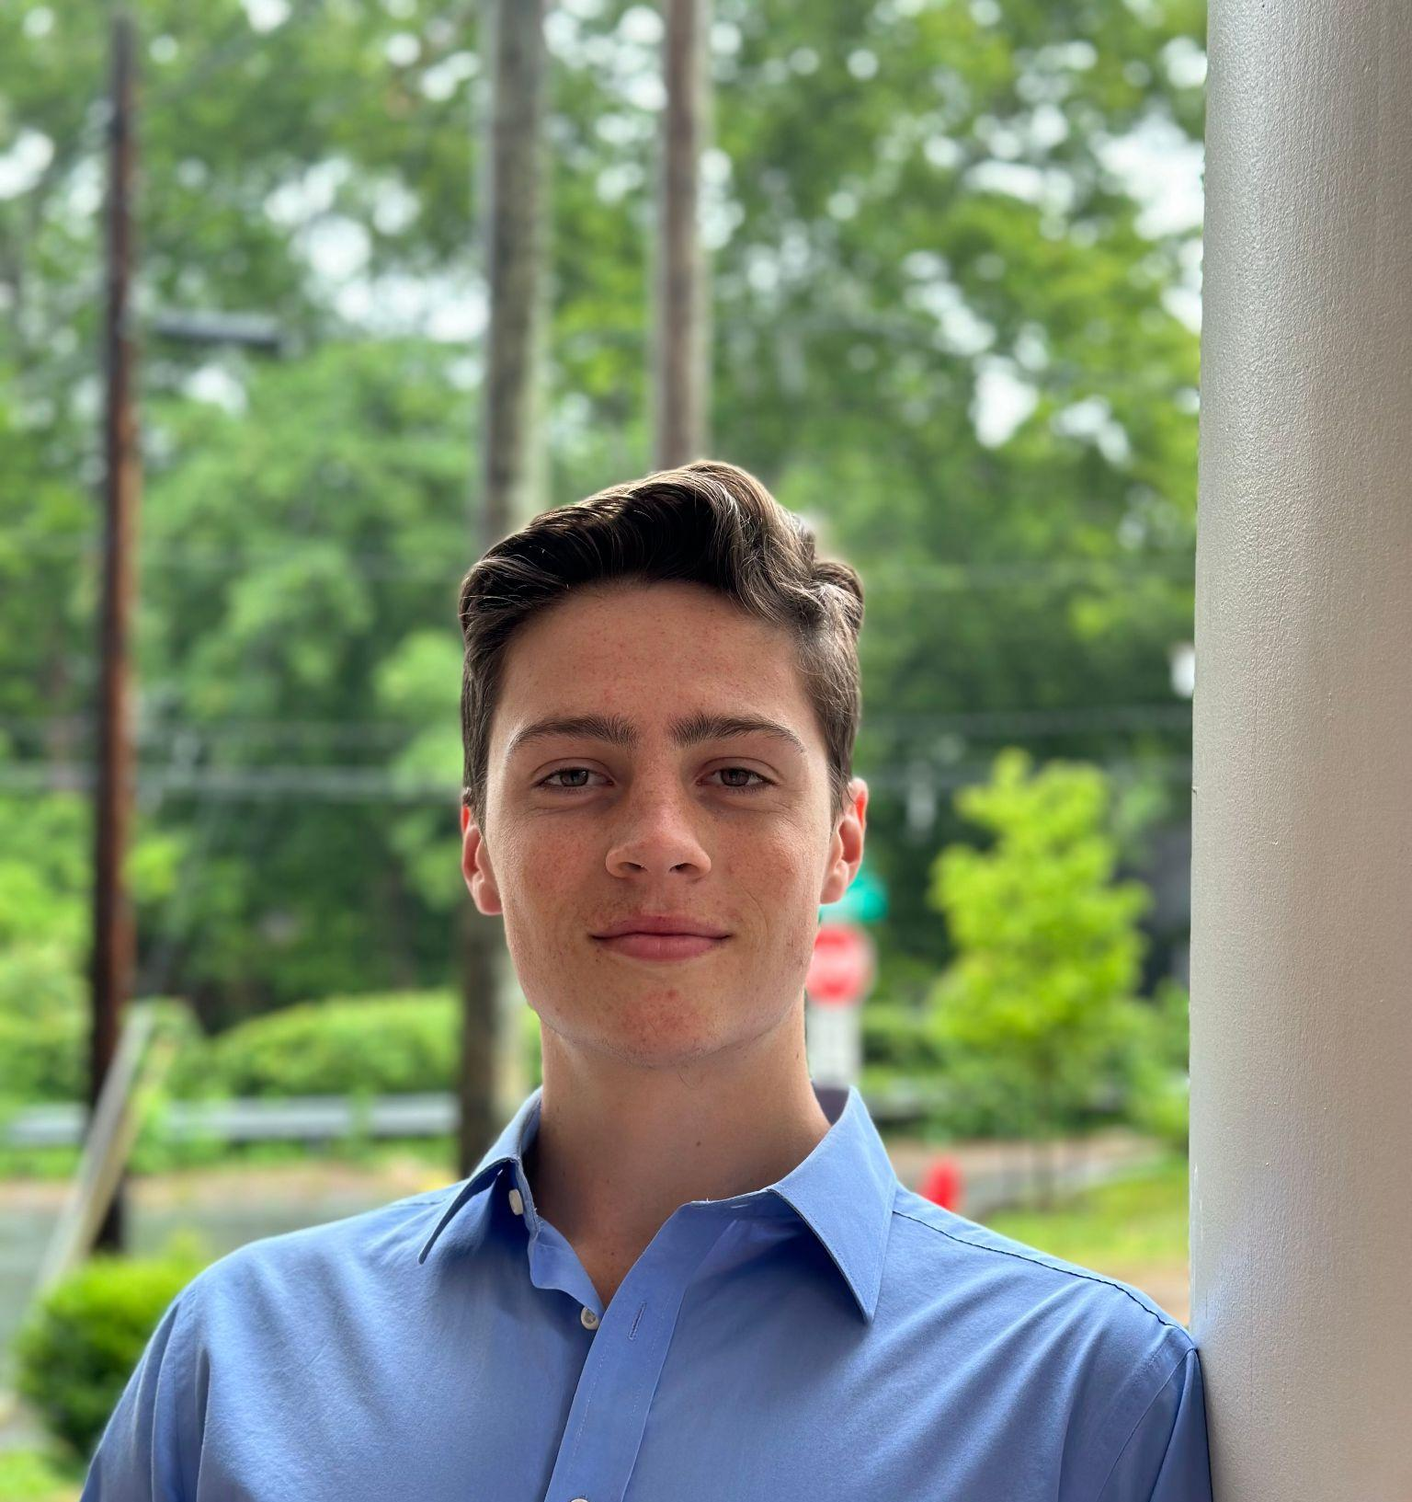
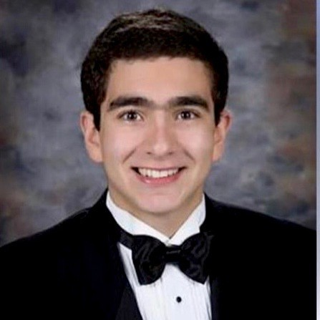


Acknowledgements
Md. Khairul Islam
Judy Fox
Andrej Erkelens
Nicholas Daniello
Yingzheng Liu
Aparna Marathe
Kingsley Kim
Zhengguang Wang
Tracy Hua
Luke Benham
George Boulos
Ayush Karmacharya
Timothy Sue
Sponsors:

